Slide 1
The Vector Projector
Gina Schmalzle
With Special thanks to Stuart Sandine and Andrea Fey

Slide 2
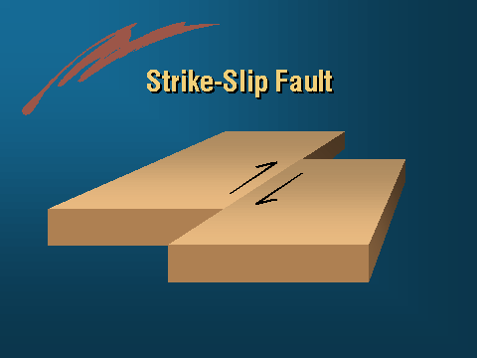
Quick and Dirty intro to Plate tectonics
Strike Slip faults --
Plates slide past each other
The largest strike slip fault in the world – The San Andreas Fault
http://www.abag.ca.gov/bayarea/eqmaps/fixit/ch2/sld003.htm

Slide 3
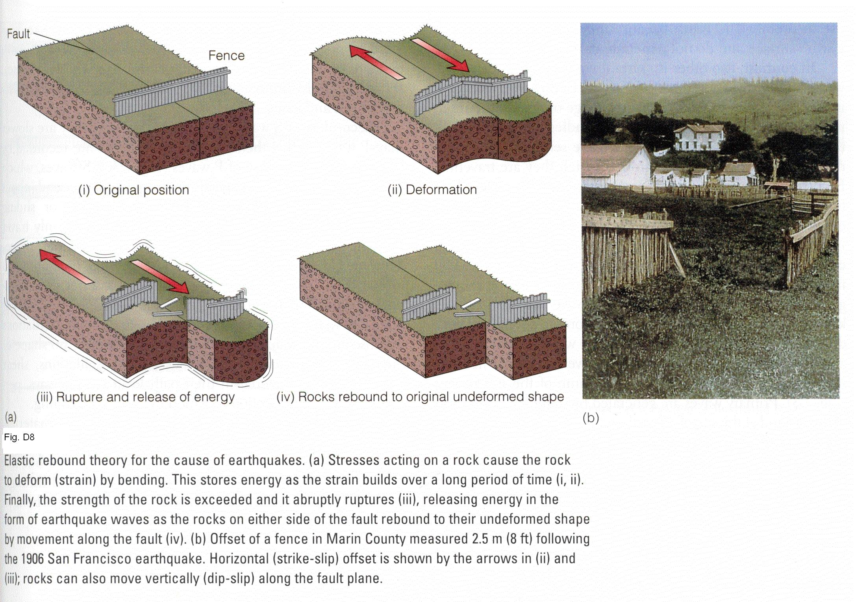
Quick and Dirty intro to Plate tectonics
http://instruct.uwo.ca/earth-sci/240a/E9.JPG

Slide 4
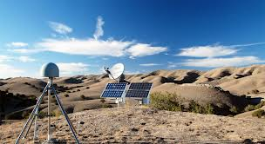
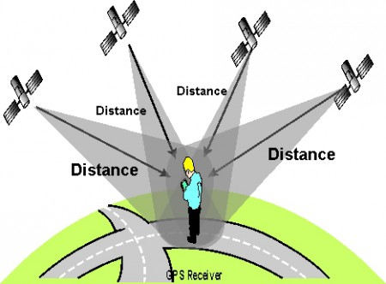
We can measure plate motions with High precision GPS
Land – based GPS – Antenna, stand, reciever
Satellites emits signals that have a defined wavelength. The number of wavelengths are counted to estimate a distance from satellite to receiver.
4 satellites are needed to get a 3D position.

Slide 5
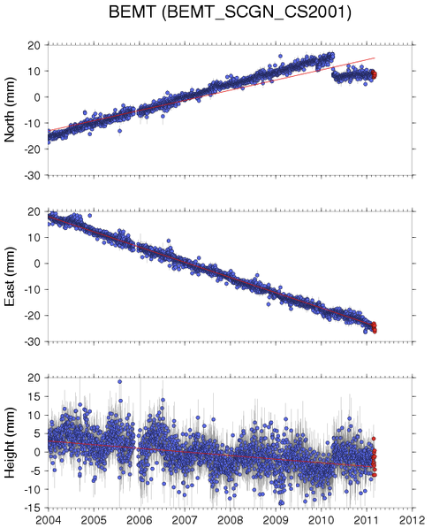
We can measure plate motions with High precision GPS
Blue dots – daily position estimates in North, East and Vertical directions for one site
Velocity is the slope.
Each site produces a velocity vector

Slide 6
And now, let me introduce you to the Vector Projector…

Slide 7
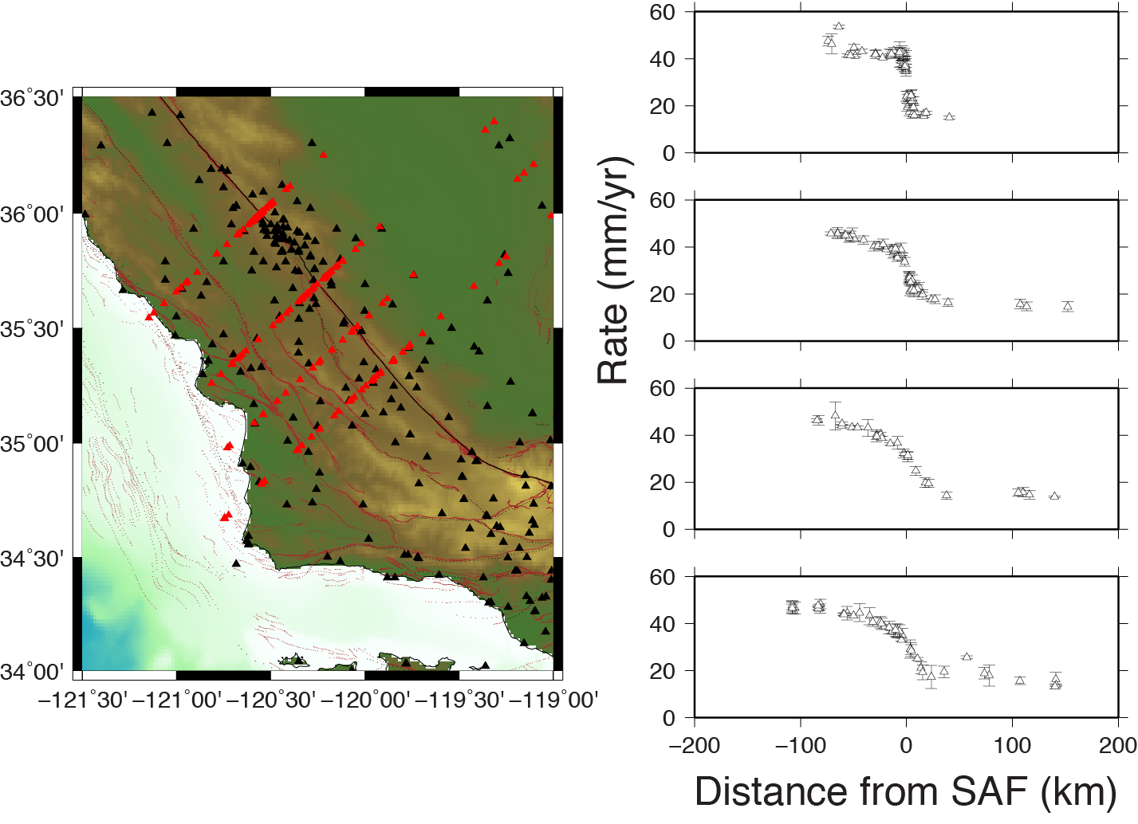
Example of where I am going with this:

